Slide 1
Brooklyn’s Best Brewery
Business plan presentation

Slide 2
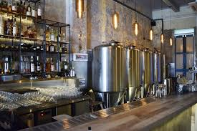

Overview
New York City is the most populous city in the United States. With an estimated 2019 population of 8,336,817 distributed over about 302.6 square miles (784 km2), New York is also the most densely populated major city in the United States. New York City is composed of five boroughs: Brooklyn, Queens, Manhattan, the Bronx, and Staten Island. The city has diverse demographics and a vibrant economy. A resident or visitor to the city can experience a vast array of cultures, including food, museums, and many other attractions.
My goal is to determine the best location to open a microbrewery and tap house in Brooklyn. Foursquare data will be used to determine location to similar venues that will attract foot traffic to the brewery.

Slide 3
Resource Requirements
Business Overview
Microbrewery with tap house in Brooklyn, NY. In-house brewery that brews and serves it’s own craft beer.
Small selection of food options provided. Located near other restaurants to give visitors other food options.
Walking distance to tourist attractions (approximately 1 kilometer)
Demand for the business. No other breweries within 1 kilometer of selected location.
Target Audience: New York city tourists and Brooklyn residents who want an authentic craft beer brewed and served on site.
Data methodology:
Foursquare API
Search for locations of similar venues
Search for nearby tourist attractions

Slide 5
Key Issues
Near term
Identify key decisions and issues that need immediate or near-term resolution.
State consequences of decision postponement.
Long term
Identify issues needing long-term resolution.
State consequences of decision postponement.
If you are seeking funding, be specific about any issues that require financial resources for resolution.

